Slide 1
Parents, Children and Pascal’s Triangle
Tulsa Math Teachers’ Circle
February 4, 2016
Led by
Jane Long
Stephen F. Austin State University

Slide 2
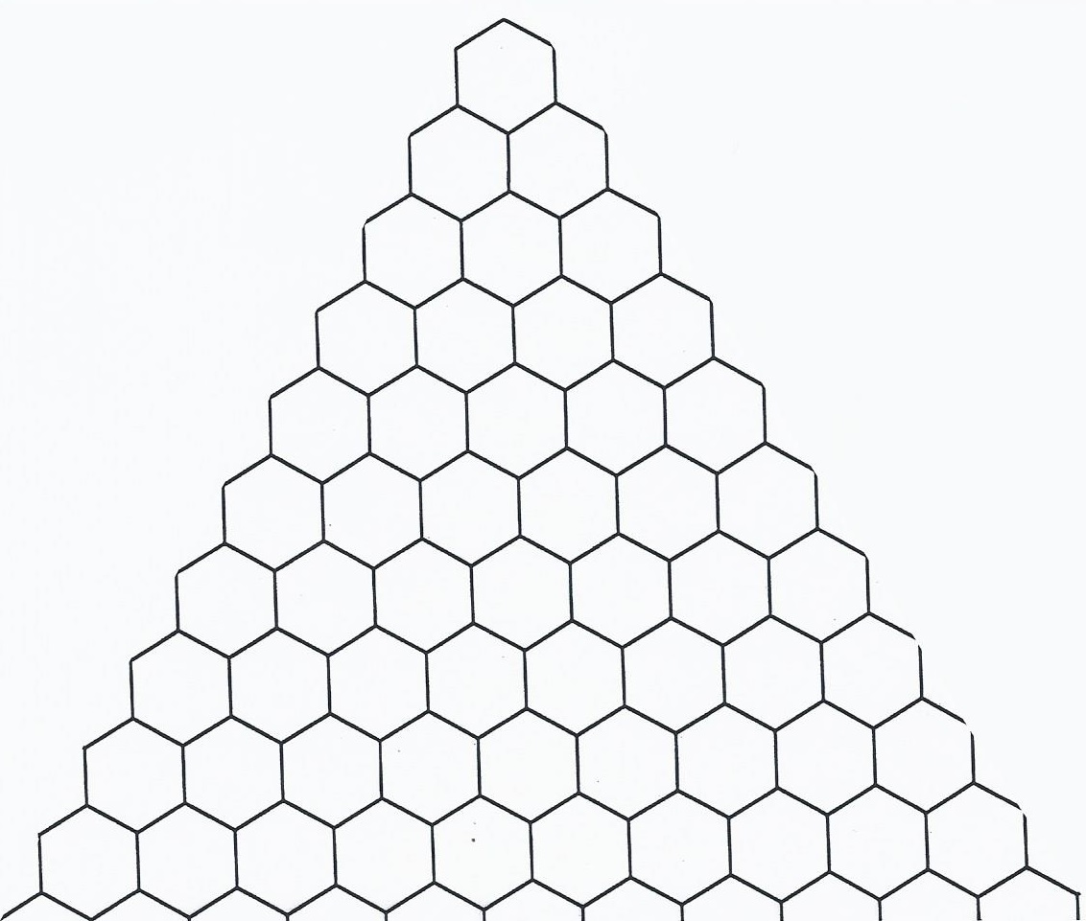
A hexagonally-tiled triangle:

Slide 3
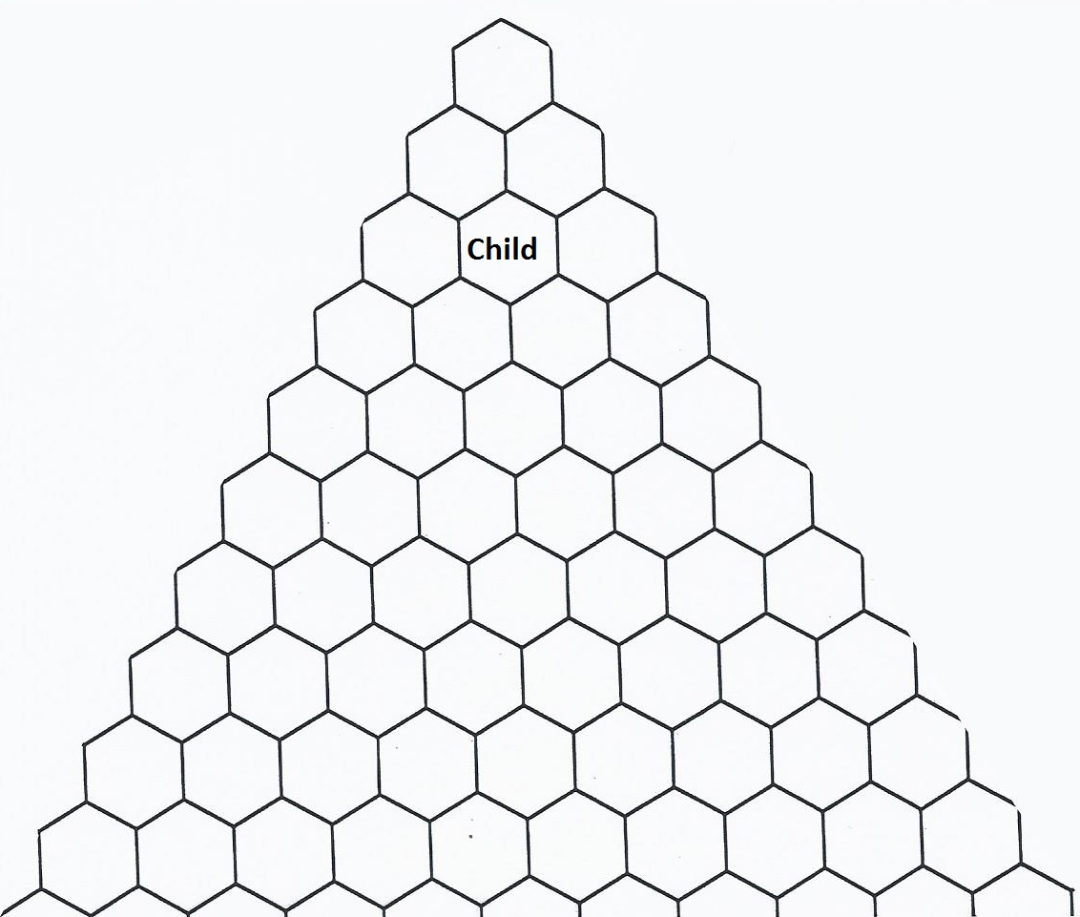
Color the hexagonally-tiled triangle…

Slide 4
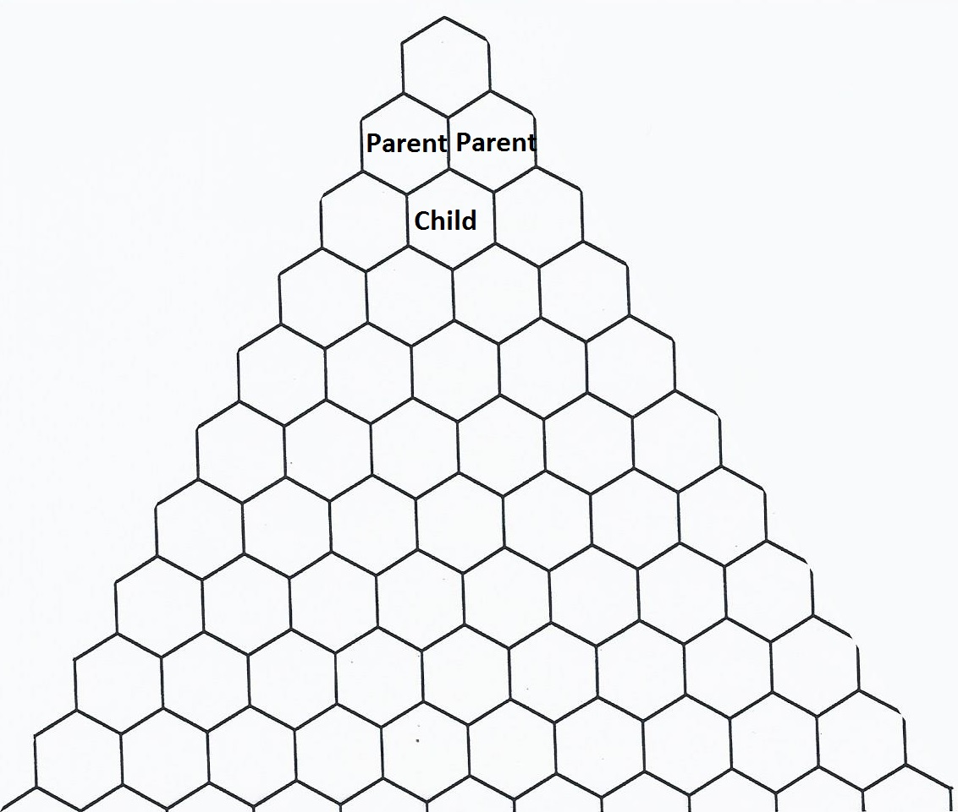
Color the hexagonally-tiled triangle…

Slide 5
Color the hexagonally-tiled triangle…
If a child’s parents are both colored the same, color the child RED
If a child’s parents are colored differently, color the child BLUE

Slide 6
Color the hexagonally-tiled triangle…
If a child’s parents are both colored the same, color the child RED
If a child’s parents are colored differently, color the child BLUE
(If a child has only one parent, color the child BLUE)

Slide 7
What is the connection to Pascal’s Triangle?

Slide 8
Pascal’s Triangle

Slide 9
WHY does this connection make sense?

Slide 10
Another “Parents and Children” Question
What is the relationship between the binomial expansion and Pascal’s triangle?

Slide 11
What is the relationship between the binomial expansion and Pascal’s triangle?
Recall:
The binomial expansion is the expanded form of
$${\left(a+b\right)}^{n}$$

Slide 12
What is the relationship between the binomial expansion and Pascal’s triangle?
Recall:
The binomial expansion is the expanded form of
$${\left(a+b\right)}^{n}$$
TRY IT!

Slide 13
How can we relate this to parents and children?

Slide 14
Related Questions
What is the sum of the entries in row n of Pascal’s Triangle? Why?

Slide 15
Related Questions
What is the sum of the entries in row n of Pascal’s Triangle? Why?
What is the sum of the entries in rows 0 through n of Pascal’s Triangle? Why?

Slide 16
Related Questions
What is the sum of the entries in row n of Pascal’s Triangle? Why?
What is the sum of the entries in rows 0 through n of Pascal’s Triangle? Why?
What would an inverted Pascal’s triangle look like?

Slide 17
Extension Questions
Imagine you throw a dart at Pascal’s triangle. What are the odds that you will hit an even number?

Slide 18
Extension Questions
Imagine you throw a dart at Pascal’s triangle. What are the odds that you will hit an even number?
Imagine you throw a dart at Pascal’s triangle. What are the odds that you will hit a multiple of 3?

Slide 19
Albany Area Math Circle: Sidewalk Chalk

Slide 20
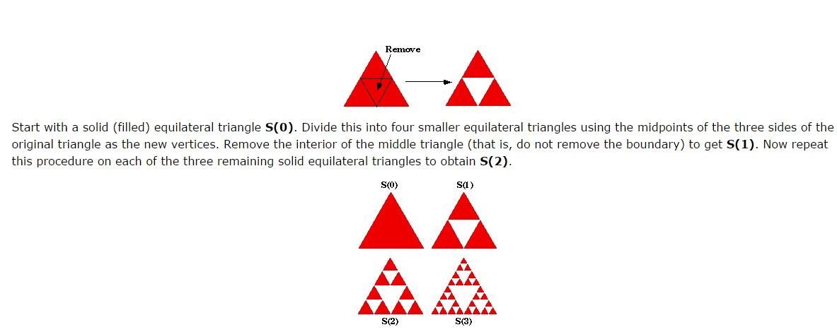
Sierpinski Triangle/Gasket
http://ecademy.agnesscott.edu/~lriddle/ifs/siertri/siertri.htm

Slide 21
Sierpinski at SFA: STEM Day 2014

Slide 22
Sierpinski at SFA: STEM Day 2014

Slide 23
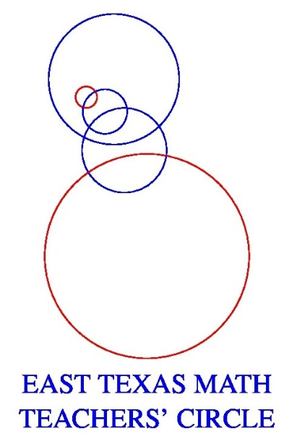
Thank you!
Check out the East Texas Math Teachers’ Circle at
http://cosm.sfasu.edu/stem/east-texas-math-teachers-circle
And me, Jane Long, at longjh@sfasu.edu

